Slide 1

Principles of Pediatric Nursing: Caring for Children
Seventh Edition
Chapter 14
Infant, Child, and Adolescent Nutrition
Revised by
Laurine Gajkowski, ND, RN, CPN
August 31, 2021
Copyright © 2017, 2015, 2012 Pearson Education, Inc. All Rights Reserved
Notes:
Nutrients critical for brain development and growth must be provided in adequate amounts.
The 2020-2025 Dietary Guidelines carries forward this emphasis on the importance of a healthy dietary pattern as a whole— rather than on individual nutrients or foods in isolation. Healthy dietary patterns support optimal growth and development.
The Science Underlying the Dietary Guidelines Demonstrates That Healthy Eating Across the Lifespan Can Promote Health and Reduce Risk of Chronic Disease
The outer bars of our Bindler model strongly influence the child’s dietary behaviors.

Slide 2
Learning Objectives
1. Discuss major nutritional concepts
2. Describe and plan nursing interventions to meet nutritional needs for all age groups
3. Integrate methods of nutritional assessment into nursing care
4. Identify and explain common nutritional problems
5. Develop nursing interventions for children with nutritional disorders.

Slide 3
Learning Objective 14.1
Discuss major nutritional concepts pertaining to the growth and development of children.

Slide 4
Updates from DGA 2020-2025
Dietary Guidelines for Americans 9th edition
By USDA, Department of Health & Human Services
DietaryGuidelines.gov
The aim of the Dietary Guidelines is to promote health and prevent disease.
The 2020-2025 Dietary Guidelines carries forward this emphasis on the importance of a healthy dietary pattern as a whole— rather than on individual nutrients or foods in isolation. Healthy dietary patterns support optimal growth and development.
The Science Underlying the Dietary Guidelines Demonstrates That Healthy Eating Across the Lifespan Can Promote Health and Reduce Risk of Chronic Disease

Slide 5
Nutrition
Definition : Intake of food/nutrients and assimilation for metabolic use
Types of nutrients
Macronutrients: Major building blocks for body
Micronutrients: Trace quantities required
Notes:
Basal Metabolic Rate (BMR)

Slide 6
Macronutrients
Types
Carbohydrates: energy source
Proteins: role in immunity and signaling, building block for muscles/organs
Fats: energy source, blood clotting & cellular processing, *brain development (myelin sheath, visual acuity, motor/cognitive function)

Slide 7
Micronutrients
Nutrient | Function | Sources
Vitamin A (and its precursor*, beta-carotene) *A precursor is converted by the body to the vitamin. | Needed for vision, healthy skin and mucous membranes, bone and tooth growth, immune system health | Vitamin A from animal sources (retinol): fortified milk, cheese, cream, butter, fortified margarine, eggs, liver Beta-carotene (from plant sources): Leafy, dark green vegetables; dark orange fruits (apricots, cantaloupe) and vegetables (carrots, winter squash, sweet potatoes, pumpkin)
Vitamin D | Needed for proper absorption of calcium; stored in bones | Egg yolks, liver, fatty fish, fortified milk, fortified margarine. When exposed to sunlight, the skin can make vitamin D.
Vitamin E | Antioxidant; protects cell walls | Polyunsaturated plant oils (soybean, corn, cottonseed, safflower); leafy green vegetables; wheat germ; whole-grain products; liver; egg yolks; nuts and seeds
Vitamin K | Needed for proper blood clotting | Leafy green vegetables such as kale, collard greens, and spinach; green vegetables such as broccoli, brussels sprouts, and asparagus; also produced in intestinal tract by bacteria
Fat-soluble vitamins
Fat-soluble vitamins
ADEK
Toxicity can occur
Water-soluble vitamins
Notes:
Vitamin K for clotting
Vitamin D
ADEK!1!! ! ! ! !

Slide 8

Figure 14-1 The U.S. MyPlate Food Guide Is Used to Provide Teaching About Amounts of Foods Recommended for Daily Intake
Source: From U.S. Department of Agriculture and U.S. Department of Health and Human Services. (2011). Retrieved from http://www.choosemyplate.gov/

Slide 9
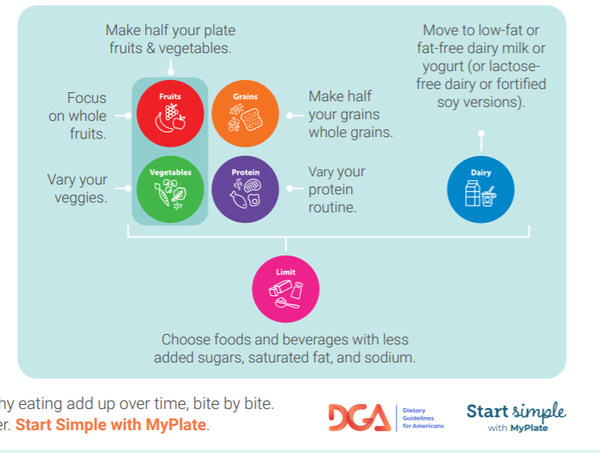
Notes:
How to teach using MyPlate. Updated in our new Dietary Guidelines 2021

Slide 10
Learning Objective 14.2
Describe and plan nursing interventions to meet nutritional needs for all age groups from infancy through adolescence
Notes:
Use https://www.dietaryguidelines.gov/ to explore requirements for pediatrics.

Slide 11
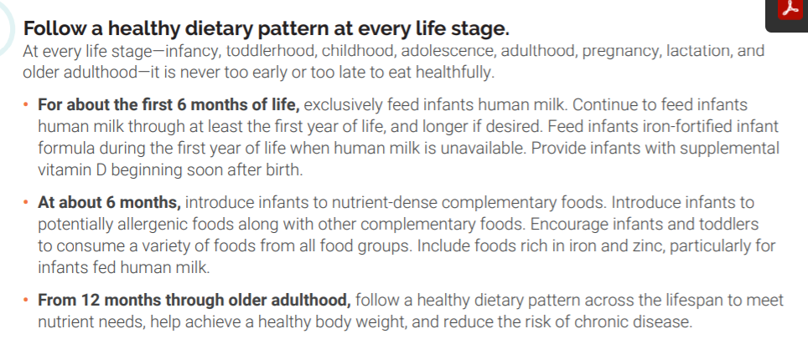
https://www.dietaryguidelines.gov/

Slide 12

Nursing Strategies to Support Nutritional Needs
Preterm and small-for-gestational-age (SGA) infants
Infancy
0 – 6 months
6 – 12 months (1st birthday)
Toddlers
Preschoolers
School-age children
Adolescents
Notes:
https://www.aap.org/en-us/advocacy-and-policy/aap-health-initiatives/HALF-Implementation-Guide/Age-Specific-Content/Pages/Infant-Timeline.aspx
Helpful

Slide 13
1. Preterm and Small-for-Gestational-Age (SGA) Infants
Immature body systems and medical problems
High calorie/kg needs
Eating disorders more common
Notes:
Have trouble eating

Slide 14
2 a. Infants Age Newborn to 6 Months
High metabolic rate and growth
At 1 month, need 100-115 kcal/kg/day
Receive about 50% of calories from fat
Double birth weight by 5 – 6 months
Notes:
DOUBLE BIRTH WEIGHT BY 6 MONTHS

Slide 15
2a. Breastfeeding Infants Age 0 to 6 Months
Exclusive feeding for 6 months
Continue through at least 12 months
Advantages
Excellent nutritional balance
Promotion of gastrointestinal function fosters immune defense
Psychologic and economic advantages
Notes:
BF is covered in your OB course.

Slide 16
2a. Formula Feeding Infants 0 to 6 Months
Types of formulas
Milk or soy based
All contain Fe^{+ (brain development)}
Specialized formulas for variety of specific needs
High calorie
Metabolic disorders found through newborn screening Phenylketonuria (P K U)
Hydrolyzed protein
Allergies
Renal failure
Notes:
Phenylketonuria (PKU) is a genetic condition that causes an amino acid called phenylalanine to build up in the body. Amino acids are the building blocks of protein. Phenylalanine is found in all proteins and some artificial sweeteners. PKU can be detected by a blood test performed via a heel stick 1-2 days after birth.

Slide 17
2a. Formula Feeding 0 to 6 Months
Nursing strategies
Education
Risk for overfeeding
Formula preparation and use
Parent–infant relationship
Prevention of early childhood caries
Notes:
Parents don’t want to waste any formula, so they coax infant to finish the bottle even after the baby is satisfied.
Formula fed babies tend to be overfed.

Slide 18

Notes:
Never microwave EBM or formula!!

Slide 19
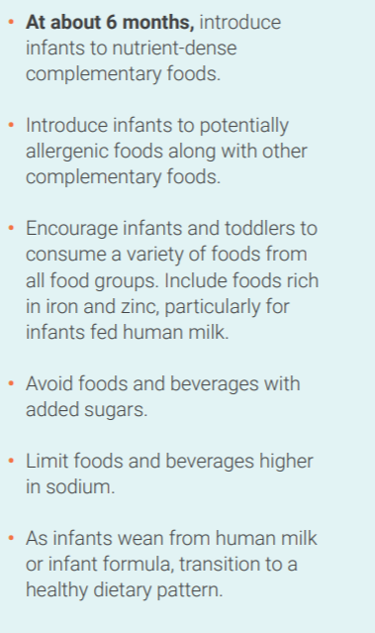
2 b. Infants Ages 6 to 12 Months
Readiness for complementary foods
Extrusion reflex is fading
Sitting skills
Gradual introduction of additional solids
Notes:
New recommendations to introduce allergenic foods (eggs, dairy, nuts). Key Takeaways From The Guidelines
The AAP guidelines recommend early, “purposeful” introduction of allergens to help reduce your baby’s food allergy risk.
They can start to sit up, which is an indication for readiness.

Slide 20
2 b. Infants Ages 6 to 12 Months
Discuss
Commercial vs. homemade foods
Timing and approach
Do NOT put thinned solids into a bottle with enlarged nipple (unless prescribed for GI reflux or swallowing pathology)
Precautions and contraindicated foods
choking hazard
Honey
Notes:
https://oversight.house.gov/sites/democrats.oversight.house.gov/files/2021-02-04%20ECP%20Baby%20Food%20Staff%20Report.pdf

Slide 21
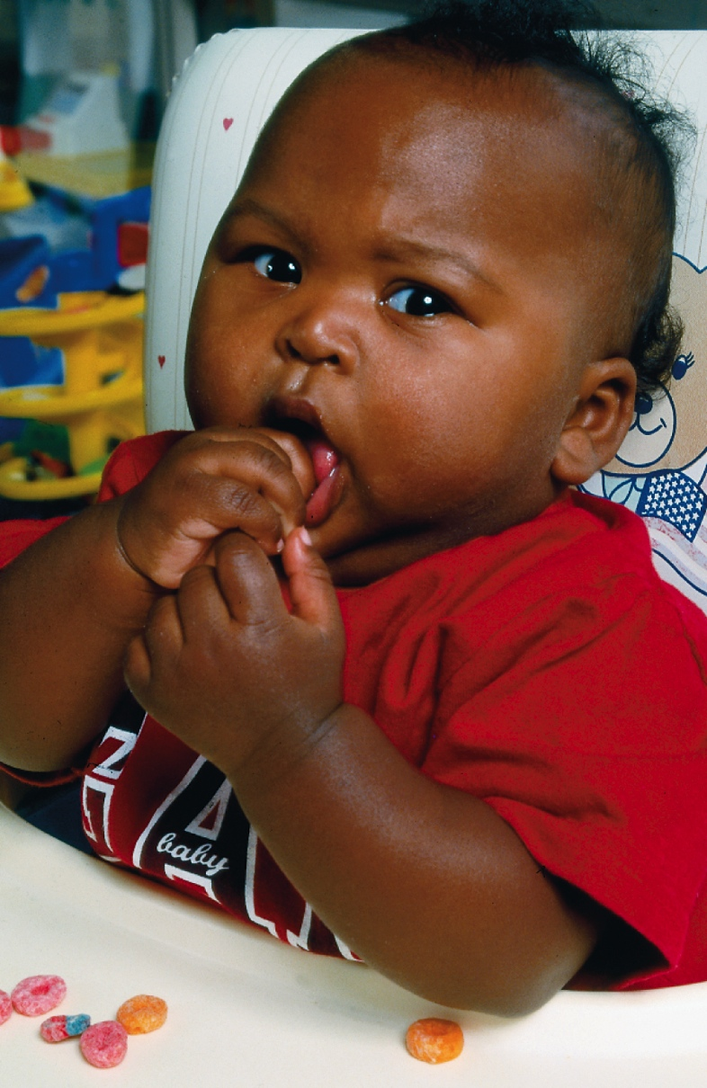
Figure 14-3 Introducing Finger Foods
The baby who has developed the ability to grasp with thumb and forefinger should receive some foods that can be held in the hand.
Palmer grasp
Notes:
Maren presents:
Stages of pincer grasp development
Pincer grasp development is usually the result of building on several grasping and coordination milestones. Some of the early developmental milestones that later allow a child to perform the pincer grasp include:
palmar grasp: bringing the fingers in toward the palm, allowing babies to curl their fingers around an object
raking grasp: using the fingers other than the thumb like a rake, curling the top of the fingers over the object to bring items toward them
inferior pincer grasp: using the pads of the thumb and index finger to pick up and hold objects; this precursor to the pincer grasp usually takes place between 7 and 8 months of age

Slide 22

2b. Infants Ages 6 to 12 Months (5 of 5)
Weaning
Giving up breastfeeding or bottle
Introduction of drinking cup about 8 or 9 months
Breastmilk or formula
Gradual process
Should be off bottle by 12 months, never at 18 months
Family and infant preferences, cultural patterns
Notes:
Never give fruit juice or another sweetened beverage in a bottle.
Bye-bye bottle

Slide 23
2 b. Infants Ages 6 to 12 Months
Dental care
Early childhood caries (ECC)
Prevention strategies
Factors in ECC
Bottle use
Prolonged nursing
Juice
Lack of Tooth care
Notes:
Bottles’ effect on teeth

Slide 24

Figure 14-2 Early Childhood Caries
This child has had major tooth decay related to sleeping as an infant and toddler while sucking bottles of juice and milk.
Source: Everst/Alamy.

Slide 25
3. Toddlers
High metabolic demands of infancy slow down.
“Physiologic anorexia”
Appears toddler does not eat enough
Nutritional needs
One tablespoon of each food per year of age
Intake patterns
Healthy meals and snacks
Self-feeding preference
Let toddler make choices

Slide 26

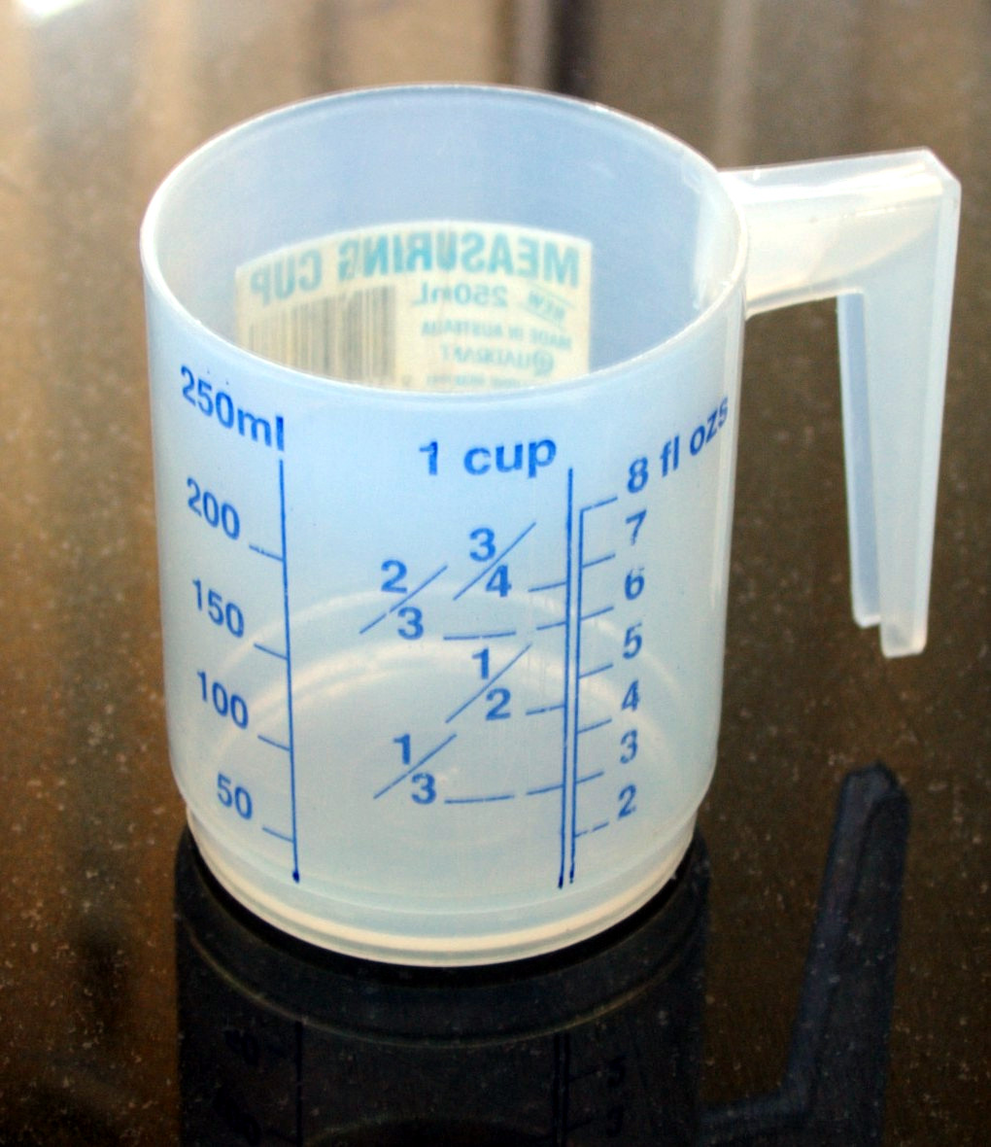
3. Toddlers
NO!
Liquids offered in a cup
Limit fruit juice to 4 oz/day
Give whole milk until age 2 years
Then switch to 2% milk
Milk intake decreases
Limit intake of milk to
16 to 24 ounces milk/day
Notes:
16 ounces equals 2 eight-ounce cups or 4 four-ounce cups
Decrease milk intake as they increase solid foods
Too much milk can prevent toddlers from learning how to chew, digestive system isn’t training itself to digest solid foods etc.
Sit in a table/high chair – minimize risk of choking

Slide 27

Figure 14-4 Fostering Healthy Eating Habits
Toddlers should sit at a table or in a highchair to eat to minimize the chance of choking and to foster positive eating patterns.

Slide 28
4. Preschoolers
Diet like that of toddlers
Socialization at mealtime
Enjoy helping with food preparation
Food jags common
Eating only a few foods for several days or weeks
Three meals and two snacks per day
Encourage good dental care.

Slide 29

Figure 14-5 Preschoolers Learn Food Habits by Eating with Others

Slide 30
5. School-Age Children
Nutritional needs increase secondary to growth spurts.
Girls by 10 or 11 years
Boys about a year later
May be resistant to new food items
Encourage appropriate food choices.
School involvement in nutrition

Slide 31
5. School-Age Children
Dental care
Tooth hygiene (flossing and brushing)
Fluoride intake
Loss of deciduous teeth
Eruption of permanent teeth

Slide 32
6. Adolescents
Growth rate
Calorie needs
Some males may need nearly 3000 cal/day.
Females 2000 cal/day
Mineral and vitamin needs
Provide food choices acceptable to teens.

Slide 33
Learning Objective 14.3
Integrate methods of nutritional assessment into nursing care of infants, children, and adolescents.

Slide 34
Analysis of Growth Measures
Measurement of weight, length, head circumference, body mass index (B M I)
Use of gender- and age-specific growth charts
Analysis of growth plots, proportionality, and patterns
Notes:
NURS 316 students must be able to plot growth measurements and make clinical judgements about pattern.

Slide 35
Physical Assessment and Laboratory Findings
Body systems affected by nutrition
Hematocrit (Hct), hemoglobin (Hgb)
Serum glucose
Lipid profile

Slide 36
Table 14–3 Clinical Manifestations of Dietary Deficiencies/Excesses (1 of 2)
Nutrient | Deficiency Manifestation | Excess Manifestation
Vitamin A | Night blindness Skin dryness and scaling | Headache Drowsiness Hepatomegaly Vomiting and diarrhea
Vitamin C | Abnormal hair (coiled shape) Skin abnormalities (dermatitis and lesions) Purpura Bleeding gums Joint tenderness Sudden heart failure | Usually none—excess is excreted in urine
Vitamin D | Rib deformity Bowed legs Bone and joint pain Muscle weakness Periodontal disease Increased rates of respiratory and skin infections/irritation | Drowsiness

Slide 37
Table 14–3 Clinical Manifestations of Dietary Deficiencies/Excesses (2 of 2)
Nutrient | Deficiency Manifestation | Excess Manifestation
B vitamins | Weakness Decreased deep tendon reflexes Dermatitis | Usually none—excess is excreted in urine
Protein | Hepatomegaly Edema Scant, depigmented hair | Kidney failure
Carbohydrate | Emaciation Decreased energy Retarded growth and development | Overweight
Iron | Lethargy Slowed growth and developmental progression Pallor | Vomiting, diarrhea, abdominal pain Pallor Cyanosis Drowsiness Shock

Slide 38
Learning Objective 14.4
Identify and explain common nutritional problems of children.
Food Insecurity, Obesity, Foodborne Illness, Contamination, Nutritional Deficiencies, Celiac,

Slide 39
Food Security and Insecurity
Food security
Access at all times to enough nourishment for a healthy, active life
Food insecurity
Inability to acquire or consume adequate quality or quantity of foods in socially acceptable ways
Childhood hunger

Slide 40
Overweight and Obesity https://www.cdc.gov/healthyweight/children/
A historic and alarming percentage of children are obese and overweight
Definitions
Obese is BMI > 95th percentile
Overweight is BMI of 85th to 94th percentile
Influencing factors
Decreased exercise patterns
Television and other screen-based activities
Percentage of calories as fat
Snacking and fast food
Notes:
CDC recommendations for maintaining healthy weight:
Develop healthy eating habits
Limit calorie-rich temptations
Help children stay active
Reduce sedentary time
5. Ensure adequate sleep

Slide 41
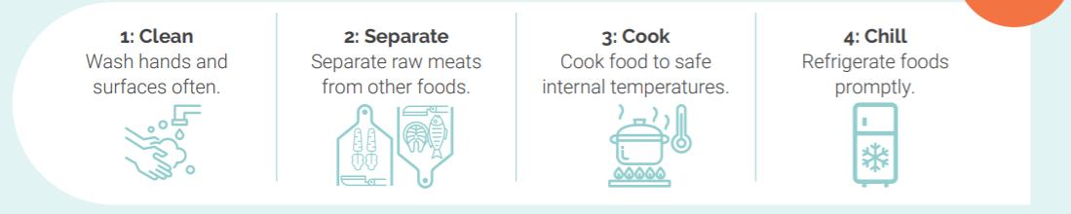
Food Safety
Foodborne illnesses range from mild to severe.
Children are at risk due to immature gastrointestinal (G I) and immune systems.
Children who are immunocompromised are at even greater risk.

Slide 42
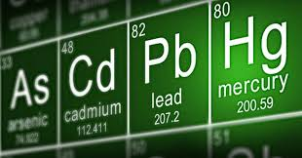
Heavy Metals Contamination (Mercury, Arsenic, Lead, Cadmium)
At-risk populations
Pregnant women (fetuses)
Infants and young children
Strategies to minimize risks
https://oversight.house.gov/sites/democrats.oversight.house.gov/files/2021-02-04%20ECP%20Baby%20Food%20Staff%20Report.pdf
Eliminate high-risk fish from diet
Food and Drug (F D A)‒recommended intake patterns
Notes:
https://www.fda.gov/food/metals-and-your-food/closer-zero-action-plan-baby-foods February 2021

Slide 43
Nutritional Deficiencies
1. Iron
2. Vitamin D
3. Folic acid
4. Protein-energy malnutrition

Slide 44
Iron Deficiency
Iron sources
Rice cereal
Iron-fortified foods
Meats
Risk groups
Infants
Adolescents
Inadequate iron consumption can result in iron deficiency anemia.

Slide 45
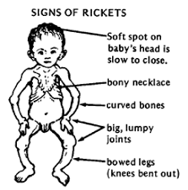
Vitamin D Deficiency
Risks
Breastfeeding
Decreased sunlight exposure
Health risks
Calcium deficiency
Rickets
Supplementation recommendation
Vitamin D 400 International Units from birth to 6 months

Slide 46
Folic Acid Deficiency
Folic acid intake prevents neural tube defects and cleft palate/lip defects.
At-risk populations
Childbearing women
Adolescents
Supplementation
0.4 mg daily
Fortified cereals and bread

Slide 47
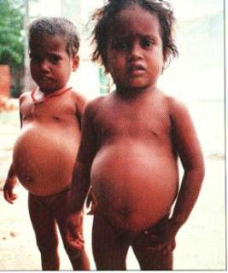
Protein-Energy Malnutrition
Both a protein and calorie deficiency
Protein deficiency
Kwashiorkor
Associated findings
Edema
Round face
Large abdomen

Slide 48
Learning Objective 14.5
Develop nursing interventions for children with nutritional disorders.

Slide 49
Conditions of Imbalanced Nutritional Intake
Avoidant/restrictive food intake
Failure to thrive (FTT) or feeding disorder
Document intake and growth pattern, provide teaching

Slide 50
Conditions of Imbalanced Nutritional Intake (2 of 3)
Anorexia nervosa
Preoccupation with weight, weight loss, and exercise
Often involves psychologic aspect, need for control
Extreme thinness, emaciation
Resulting imbalances may lead to arrhythmias, death
Psychologic treatment, nutrition, medication

Slide 51
Conditions of Imbalanced Nutritional Intake (3 of 3)
Bulimia nervosa
Binge eating and purging
“Silent” disorder, easily concealed
Eroded tooth enamel
Gum recession and caries
Calluses on back of hand
Abdominal distention
Provide cognitive-behavior therapy along with physiologic care.

Slide 52
Address Nutritional Needs for Children With Health Conditions
Increased nutritional needs
Assess factors affecting meeting of nutritional needs.
Examples of specific conditions

Slide 53
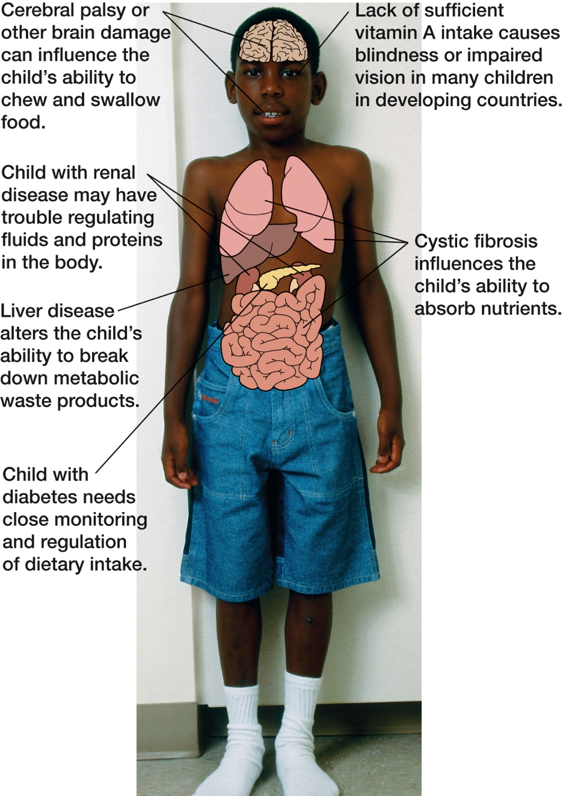
Conditions That Influence Nutritional Needs

Slide 54
Celiac Disease
Gluten sensitivity of chronic malabsoorption
Immunologic disorder
Intolerance to gluten (in wheat, barley, rye, oats)
Affects intestinal absorption of fat, protein, carbohydrates, calcium, iron, folate, vitamin A, D, E, K,
Usually presents 6 months to 2 years
Dietary exclusion allows return to normal growth.

Slide 55
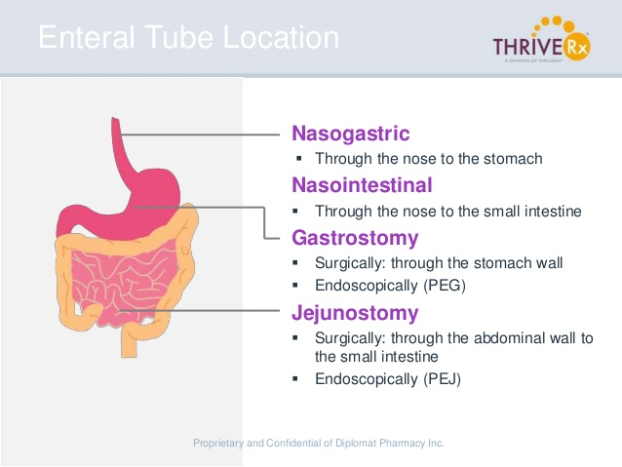
Enteral Therapy
Uses
Types
Nasogastric
Gastrostomy
Jejunostomy
Nursing responsibilities
Assessment
Monitoring and maintenance of tube and insertion site
Administration of feedings

Slide 56
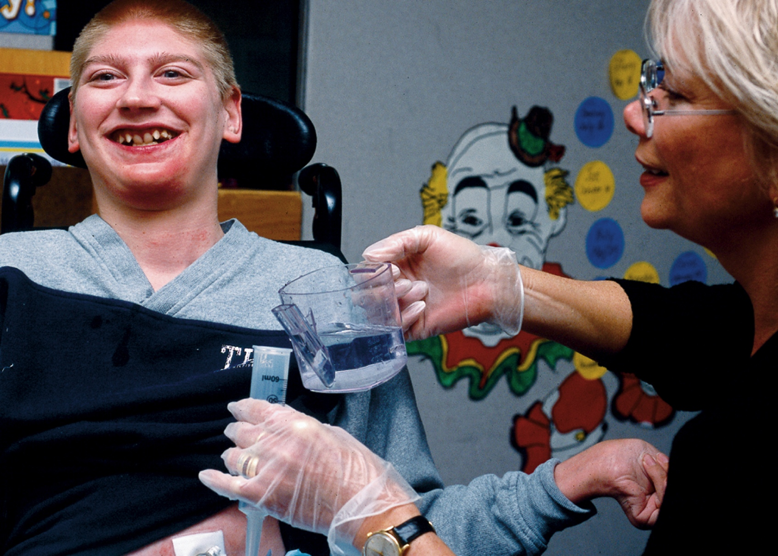
Figure 14-11 Enteral Therapy. This Child Has Returned to School Following Surgery. He Has Difficulty Chewing and Swallowing Food Due to Cerebral Palsy. The School Nurse Has Taught His Teacher How to Safely Administer Some Enteral Feedings During School Hours

Slide 57
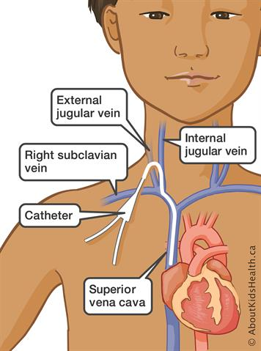
Total Parenteral Nutrition
Uses (examples: congenital GI malformation, support after bone marrow transplant)
Solution components
Lipid emulsions
Nursing responsibilities
Assessment
Administration
Prevention of complications

Slide 58

Copyright

